Slide 1
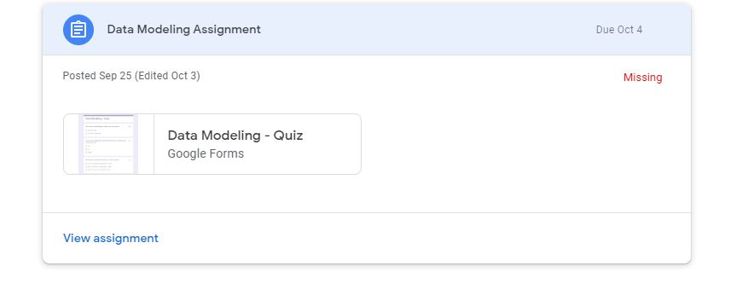
Step 1: Click on the View assignment as indicated with an arrow.

Slide 2
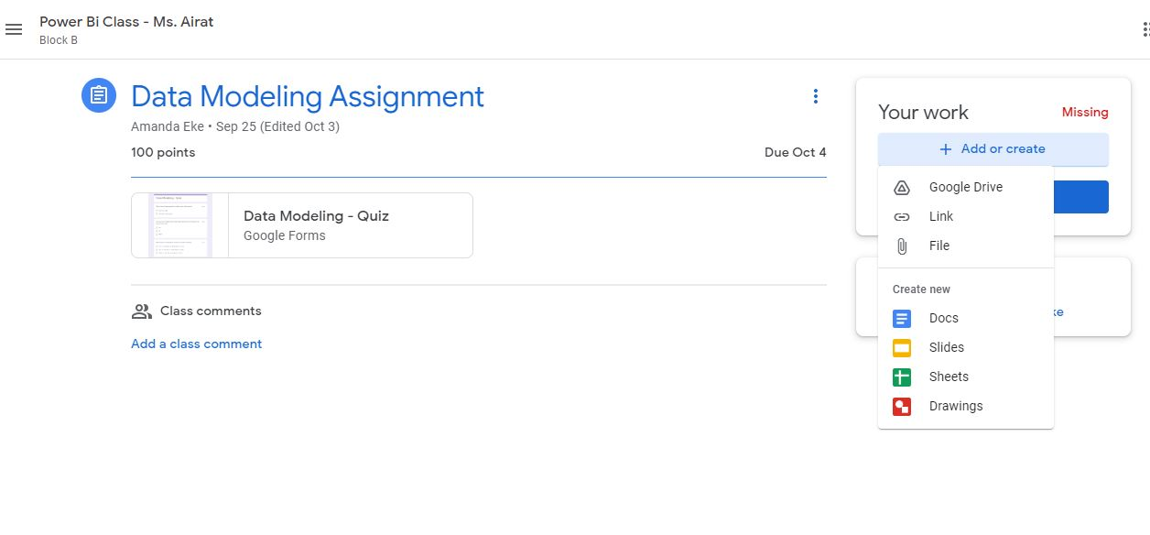
Step 2: Click on Add or create, then click on the File to upload from your local computer or click on Google Drive to upload from your drive.

Slide 3
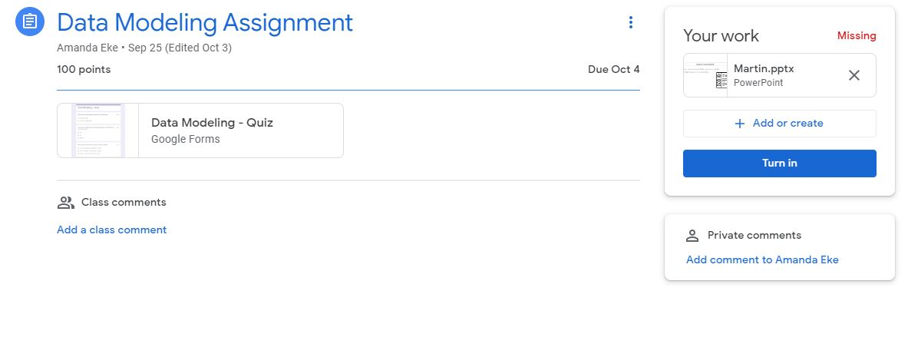
Step 3: After uploading your file, click on the Turn in to turn in your assignment.

